Slide 1
Chapter-11 Sampling
Topics Discussed
POPULATION, ELEMENT, POPULATION FRAME ,SAMPLE , SUBJECT
SAMPLING
REASONS FOR SAMPLING
REPRESENTATIVENESS OF THE SAMPLE
PROBABILITY SAMPLING
Simple Random Sampling
Systematic sampling
Stratified Random Sampling: Proportionate and Disproportionate
Cluster sampling: single- stage and multi- stage
Area Sampling
Double Sampling
NON PROBABILITY SAMPLING
Convenience Sampling
Judgment Sampling
Quota Sampling
SAMPLE SIZE

Slide 2
POPULATION, ELEMENT, POPULATION FRAME ,SAMPLE , SUBJECT
Population: Population refers to the entire group of people, events, or things of interest that the researcher wishes to investigate.
Element: An Element is a single member of the population. If 1000 workers in a particular organization happen to be the population of interest to a researcher , each worker therein is an element
Population frame: The population frame is a listing of all the elements in the population from which the sample is drawn. The payroll of an organization would serve as the population frame if its members ate to be studied. Likewise, the university registry containing a listing of all students, faculty, administrators, and support staff in the university during a particular academic year or semester could serve as the population frame for a study of the university population.

Slide 3
POPULATION, ELEMENT, POPULATION FRAME ,SAMPLE , SUBJECT
Sample : A sample is a subset of the population. It comprises some members selected from it. In other words, some but not all, elements of the population would form the ample. If 200 members are drawn from a population of 1000 blue-collar workers, these 200 members form the sample for the study.
Subject : A subject is a single member of the sample, just as an element is single member of the population. If 200 members from the total population of 1000 blue-collar workers formed the sample for the study, then each blue0collar worker in the sample is a subject.

Slide 4
Sampling
Sampling is the process of selecting a sufficient number of elements from the population, so that a study of the sample and an understanding of its properties or characteristics would make it possible for us to generalize such properties or characteristics to the population elements. The characteristics of the population such as μ (the population mean), σ (the population standard deviation), and σ² ( the population variance) are referred to as its parameters.
Reasons for sampling:
The reasons for using a sample, rather than collecting data from the entire population, are self-evident. In research investigations involving several hundred and even thousands of elements, it would be practically impossible to collect data from, or test, or examine every element. Even if it were possible, it would be prohibitive in terms of time, cost, and other human resources. Study of a sample rather than the entire population is also sometimes likely to produce more reliable results.

Slide 5
Sampling (contd..)
Representativeness of sample
If we choose the sample in a scientific way, we can be reasonably sure that the sample statistics is fairly close to the population parameter. It is possible to choose the sample in a such a way that it is representative of the population
Normality of Distributions
Attributes or characteristics of the population are generally normally distributed. For instance, when attributes such as height and width are considered , most people will be clustered around the mean, leaving only a small number at the extremes who are either very tall or very short, very heavy or very light, and so on.

Slide 6
Probability Sampling
When elements in the population have a known chance of being chosen as subjects in the sample, we resort to a probability sampling design. Probability sampling can be either unrestricted (simple random sampling) or restricted (complex probability sampling) in nature.
Simple Random Sampling
In the unrestricted probability sampling design, more commonly known as simple random sampling, every element in the population has a known and equal chance of being selected as a subject.
Restricted or Complex probability sampling
As an alternative to the simple random sampling design, several complex probability sampling (restricted probability) designs can be used. These probability sampling procedures offer a viable, and sometimes more efficient alterative to the unrestricted design.
Systematic Sampling
The systematic sampling design involves drawing every nth element in the population starting with a randomly chosen element between 1 and n.

Slide 7
Probability Sampling (contd..)
Stratified Random Sampling
While sampling helps to estimate population parameters, there may be identifiable subgroups of elements within the population that may be expected to have different parameters on a variable of interest to the researcher.
Stratified random sampling involves a process of stratification or segregation, followed by random selection of subjects from each stratum. The population is first divided into mutually exclusive groups that are relevant, appropriate, and meaningful in the context of the study.
Proportionate and Disproportionate Stratified Random Sampling
Once the population has been stratified in some meaningful way, a sample of members from each stratum can be drawn using either a simple random sampling or a systematic sampling procedure. The subjects drawn from each stratum can be either proportionate or disproportionate to the number of elements in the stratum.
Disproportionate sampling decisions are made ether when some stratum or strata are too small or too large, or when there is more variability suspected with a particular stratum.
In summary, stratified random sampling involves stratifying the elements along meaningful level and taking proportionate or disproportionate samples for thee strata.

Slide 8
Probability Sampling (contd..)
Cluster Sampling
When several groups with intragroup heterogeneity and intergroup homogeneity are found, then a random sampling of the clusters or groups can ideally be done and information gathered from each of the members in the randomly chosen clusters.
Single-Stage and Multistage Cluster Sampling
Single stage cluster sampling involves the division of the population into convenient clusters, randomly choosing the required number of clusters as sample subjects, and investigating all the elements in each of the randomly chosen clusters. Cluster sampling can also be done in several stages and is then known as multistage cluster sampling.
Area Sampling
The area sampling design constitutes geographical clusters. That is, when the research pertains to populations within identifiable geographical areas such as counties, city blocks, or particular boundaries within a locality, area sampling ca be done. Thus, area sampling is a form of cluster sampling within an area

Slide 9
Probability Sampling (contd..)
Double Sampling
This plan is resorted to when further information is needed from a subset of the group from which some information has already been collected for the same study. A sampling design where initially a sample is used in a study to collect some preliminary information of interest and later a sub sample of this primary sample is used to examine the matter in more detail, is called double sampling.

Slide 10
Non-Probability Sampling
In nonprobability sampling designs, the elements in the population do not have any probabilities attached to their being chosen as sample subjects. This means that the findings from the study of the sample cannot be confidently generalized to the population. As stated earlier, however, researchers may at times be less concerned about generalizability than obtaining some preliminary information in a quick and inexpensive way. They would then resort to nonprobability sampling. Sometimes nonprobability sampling could be the only way to obtain data.
Convenience Sampling
Convenience sampling refers to the collection of information from members of the population who are conveniently available to provide it.
Purposive Sampling
Instead of obtaining information from those who are most readily or conveniently available, it might sometimes become necessary to obtain information from specific target groups. The sampling here is confined to specific types of people who can provide the desired information, either because they are only ones who have it, or conform to some criteria set by the researcher.

Slide 11
Non-Probability Sampling (contd..)
Judgment Sampling
Judgment sampling involves the choice of subjects are most advantageously placed or in the best position to provide the information required.
Quota Sampling
Quota sampling, a second type of purposive sampling, ensures that certain groups are adequately represented in the study through the assignment of a quota. Generally, the quota fixed for each subgroup is based on the total numbers of each group in the population. However, since this is a nonprobability sampling plan, the results are not generalizable to the population.
Quota sampling can be considered as a from of proportionate stratified sampling, in which a predetermined proportion of people are sampled from different groups, but on a convenience basis.

Slide 12
Sample Size
Rules of thumb for determining sample size.
Sample sizes larger than 30 and less than 500 are appropriate for most research
Where samples are to be broken into subsamples; (male/females, juniors/seniors, etc ), a minimum sample size of 30 for each category is necessary.
In multivariate research ( including multiple regression analyses), the sample size should be several times (preferably 10 times or more) as large as the number of variables in the study.
For simple experimental research with tight experimental controls (matched pairs, etc.), successful research is possible with samples as small as 10 to 20 in size.

Slide 13
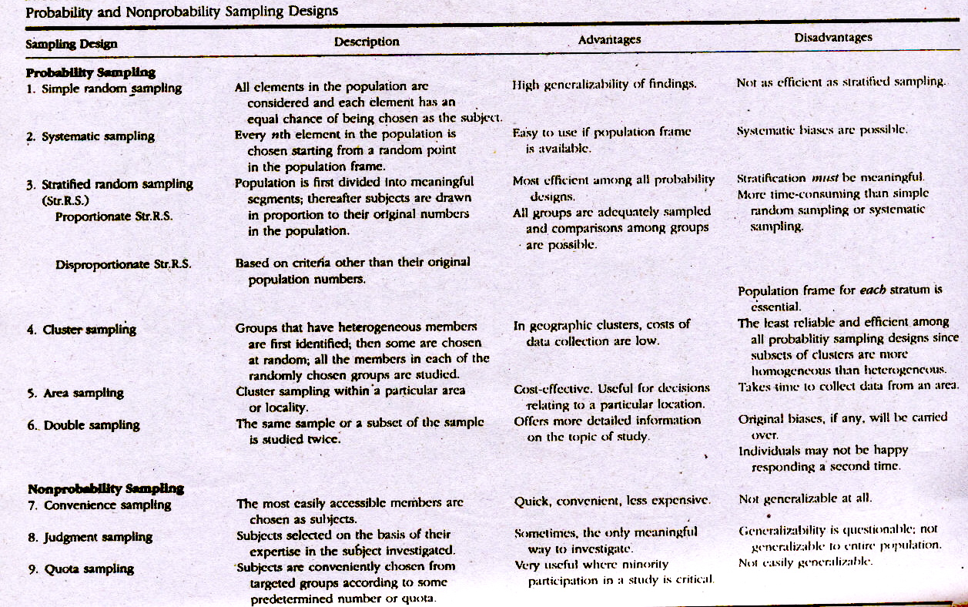

Slide 14
